Slide 1

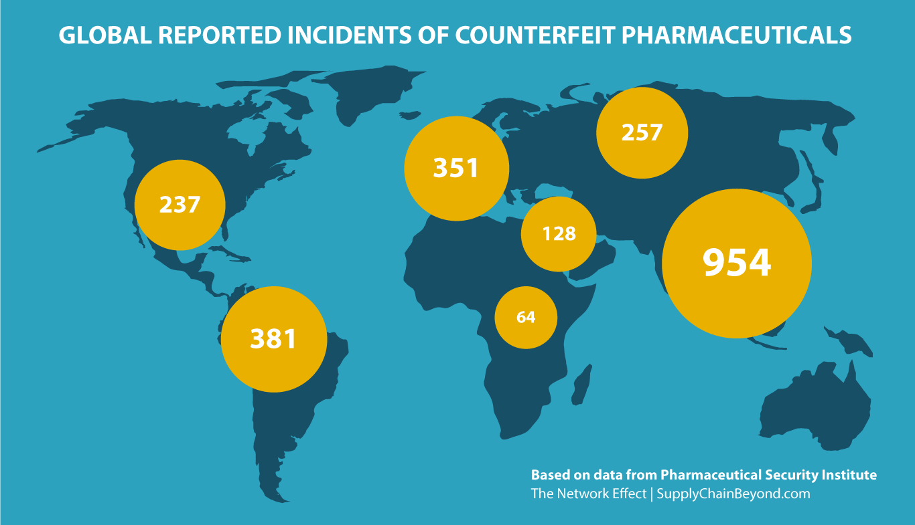
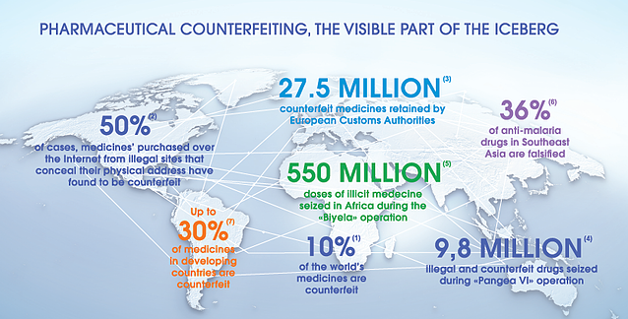
Using Blockchain to bolster pharmaceutical and medical device supply chain provenance and transparency.
Matthew De Giorgio | K. Hautala-Hili | Institute of Information and Communication Technology | Institute of Business and Commerce
Problem Statement
Methodology
Research Questions
The purpose of this study is to explore the advances that blockchain brings to the pharmaceutical industry in terms of Drug authentication mainly focusing on the supply chain level.
Phase I
Phase II
Phase III
What are the main benefits of implementing blockchain technology within the pharmaceutical market?
How feasible is the implementation of blockchain technology in the local market?
Focusing Purely on the supply chain, can blockchain help solve the locally issues?
Research Approach
The core methodology consists of the following; The core concepts and ideas to be discussed during the interviews are prepared and sent to all participants a few weeks before the actual interview. During the interview, the interviewee may follow the provide document or discuss different insights related to the core concept. Once all Interviews are completed, all transcripts will be coded and undergo thematic analysis to extract the key insights that are relevant to the research propositions.
The Research project will take a qualitative approach that focuses on using interviews to gather perspectives from business leaders. This approach was taken to keep the research relevant to the end users of such technologies which in this case would be the businesses in the local pharmaceutical market.
Project Overview
Blockchain and distributed ledger technology-based projects are appearing in every industry due to the many possible advancements they could provide especially in audit trail applications. Enterprise software companies such as SAP are teaming up with world leading pharmaceutical companies to develop tracking systems that allow drug wholesalers to authenticate pharmaceuticals as they travel along the supply chain from manufacturing down to the end consumer/patient.
References
Bhardwaj, G. (2018). Five use cases for blockchain in pharma - Pharmaphorum. [online] Pharmaphorum. Available at: https://pharmaphorum.com/views-and-analysis/five-use-cases-for-blockchain-in-pharma/ [Accessed 20 Jan. 2019].
Holland, R. (2017). 83% of Life Science Leaders Believe Blockchain will be Adopted Within Five Years, Finds Survey from The Pistoia Alliance - Pistoia Alliance. [online] Pistoiaalliance.org. Available at: https://www.pistoiaalliance.org/83-life-science-leaders-believe-blockchain-will-adopted-within-five-years-finds-survey-pistoia-alliance/ [Accessed 18 Jan. 2019].
Kamel Boulos, M., Wilson, J. and Clauson, K. (2019). Geospatial blockchain: promises, challenges, and scenarios in health and healthcare. [online] International Journal of Health Geographics. Available at: https://ij-healthgeographics.biomedcentral.com/articles/10.1186/s12942-018-0144-x [Accessed 18 Jan. 2019].
Ledwith, S. (2018). Blockchain explained. [online] Reuters. Available at: https://graphics.reuters.com/TECHNOLOGY-BLOCKCHAIN/010070P11GN/index.html [Accessed 19 Jan. 2019].
Penski, L. (2019). Blockchain Co-Innovation in the Pharmaceutical Industry | SAP Blogs. [online] Blogs.sap.com. Available at: https://blogs.sap.com/2018/04/17/blockchain-co-innovaion-in-the-pharmaceutical-industry/ [Accessed 19 Jan. 2019]

